Slide 1
$unwind

Slide 2
$unwind
$unwind takes an array attribute, and returns one document for each element in the array.
$unwind is used to “flatten” documents with arrays into a more table-like structure suitable for further analysis

Slide 3
High level syntax
{$unwind:{arrayElement}}

Slide 4
High level syntax

Slide 5
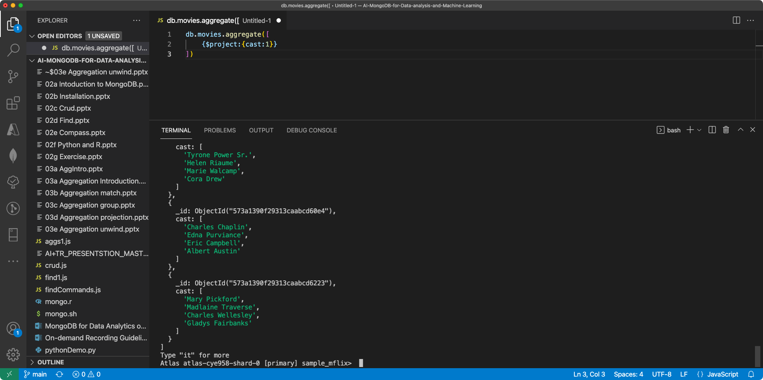

Slide 6
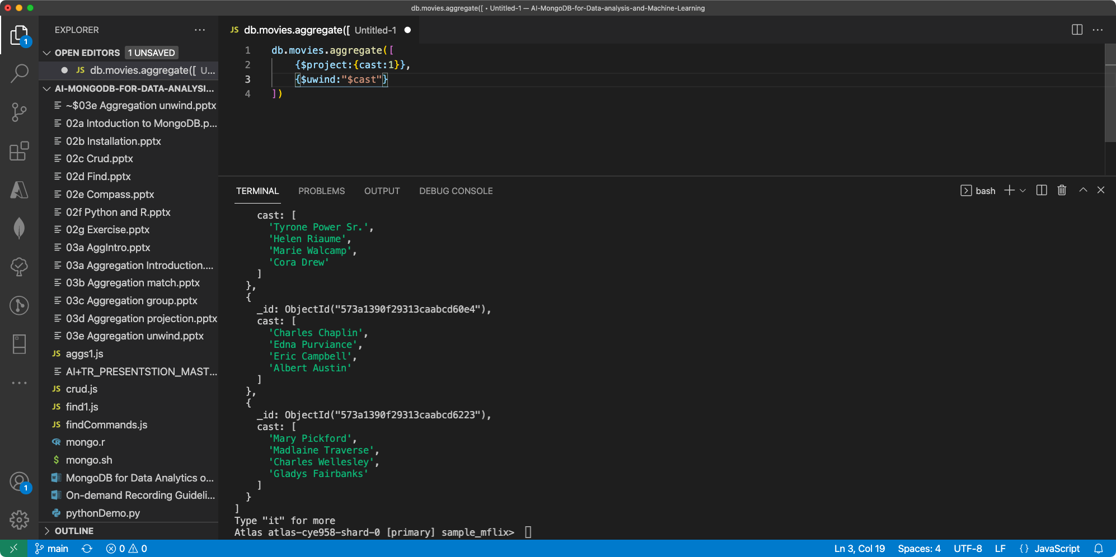

Slide 7
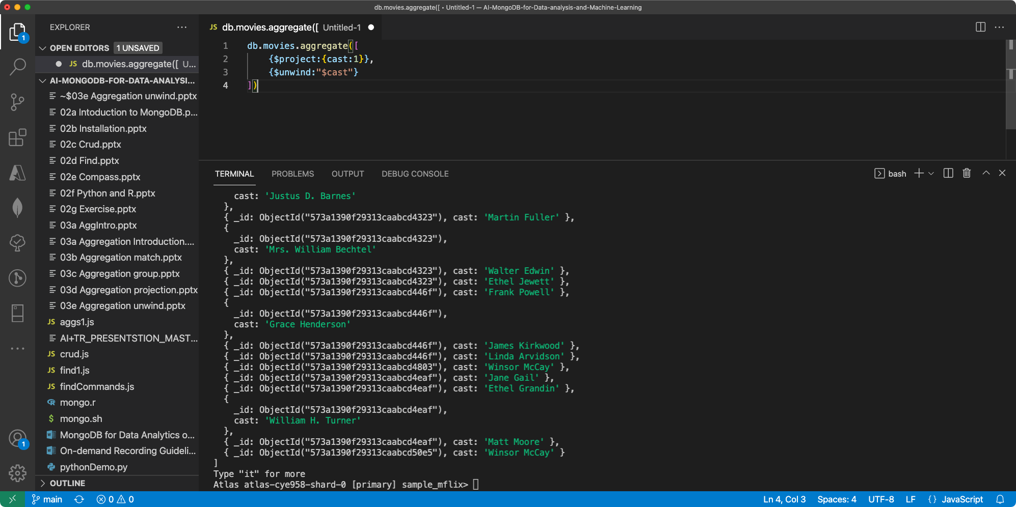

Slide 8
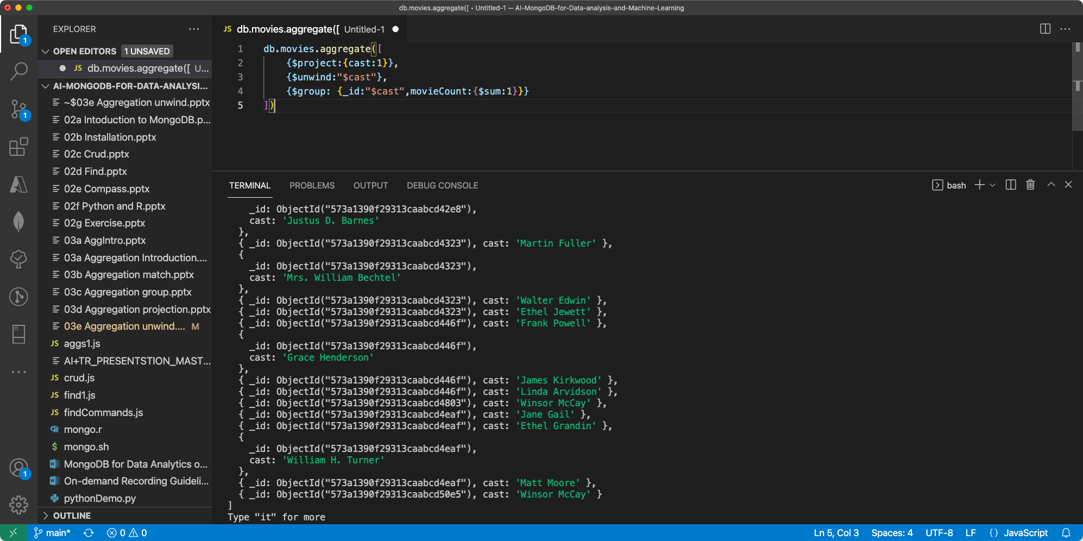
db.movies.aggregate([
{$project:{cast:1}},
{$unwind:"$cast"},
{$group: {_id:"$cast",movieCount:{$sum:1}}}
])

Slide 9
